Slide 1
Data Handling
12 October 2021
James Brenton and Mark Fernandes

Slide 2
Goals
Agreement that these are critical (!)
Strong data exploration skills
OpenRefine -> dplyr -> ggplot workflow
R markdown document for all lab results
Aspiration for high quality data carpentry (version control with git)
Understanding
Limitations of excel
Good working practices upstream of R and other tools
Tidy data
Joins (introduction)

Slide 3
Develop safe data practices for handling your primary data
keep primary data unaltered
Use consistent identifiers (ISO date format e.g. 2020-10-12; integer identifiers e.g. JBLAB-XXXX)
What are the relationships between your experiments and data?
Use an electronic notebook
Have a backup strategy
Use a database
Data file 1
Data file 2
Researcher
Experiment
Data file 3

Slide 4
The 13 critical rules for using Excel
https://kbroman.org/dataorg/

Slide 5
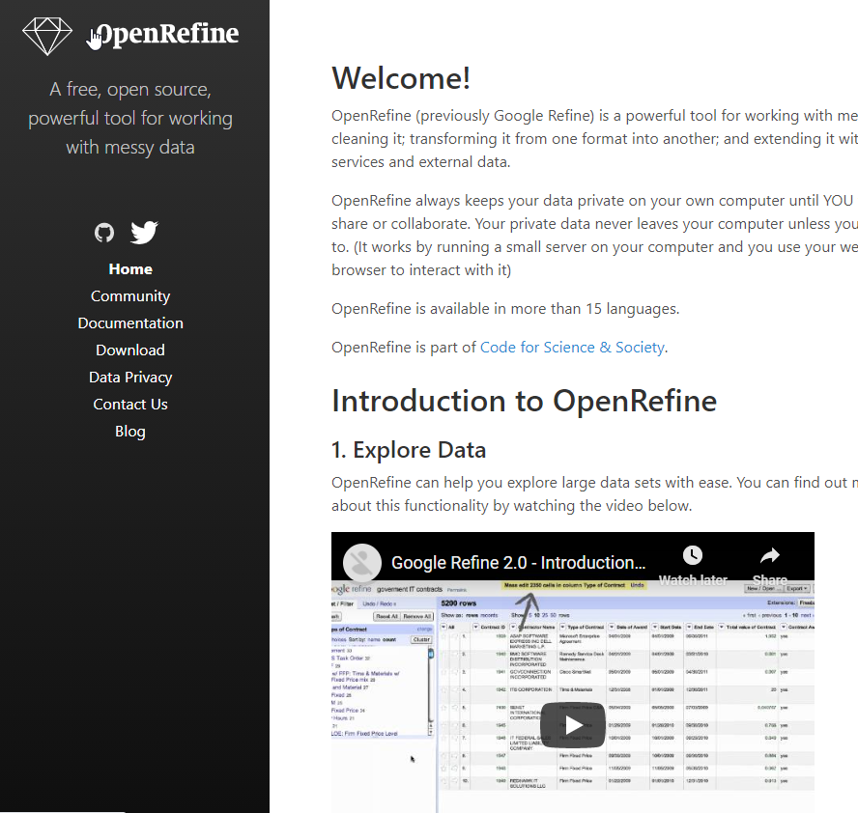
Get good at data cleaning and exploratory data analysis
Don’t use Excel for data cleaning
Learn OpenRefine
https://openrefine.org/

Slide 6
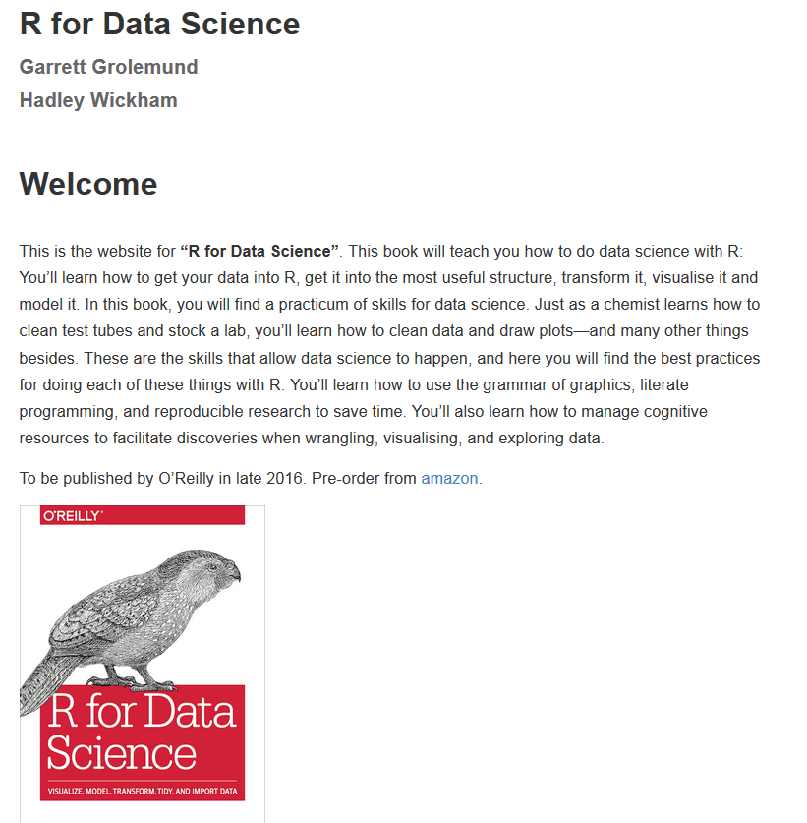
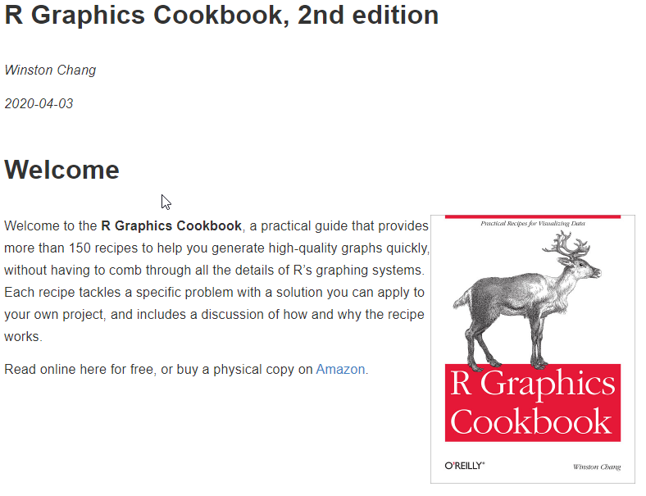
Use R for your analyses
http://r4ds.had.co.nz/
https://r-graphics.org/

Slide 7
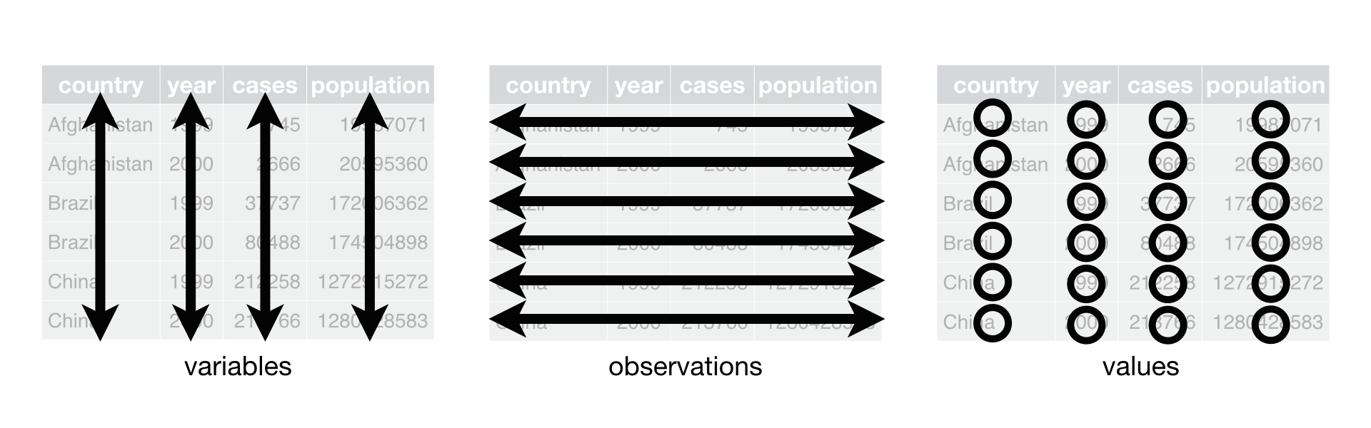
Make your data tidy (this saves you time!)
“Happy families are all alike; every unhappy family is unhappy in its own way” –– Leo Tolstoy
“Tidy datasets are all alike, but every messy dataset is messy in its own way” –– Hadley Wickham
Each variable must have its own column
Each observation must have its own row
Each value must have its own cell

Slide 8
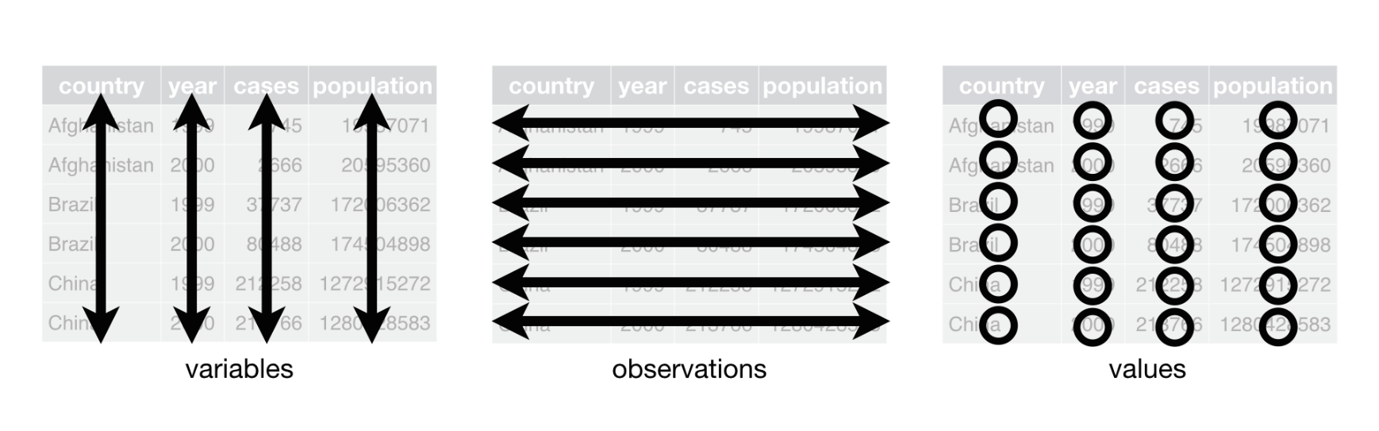
Why use tidy data?
Provides a consistent way of storing data for your analyses
Consistent data structures make it much easier to learn the tools that work with it because they have an underlying uniformity
Placing variables in columns allows R (and other tools) to work efficiently. Most built-in R functions, work with vectors of values.
You want to make transforming (tidy) data feel natural and easy

Slide 9
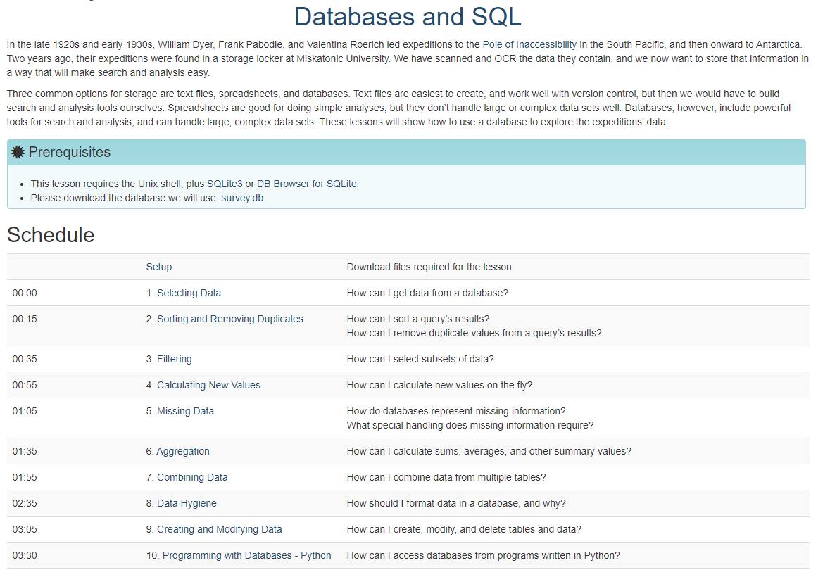
Use a database for your data

Slide 10
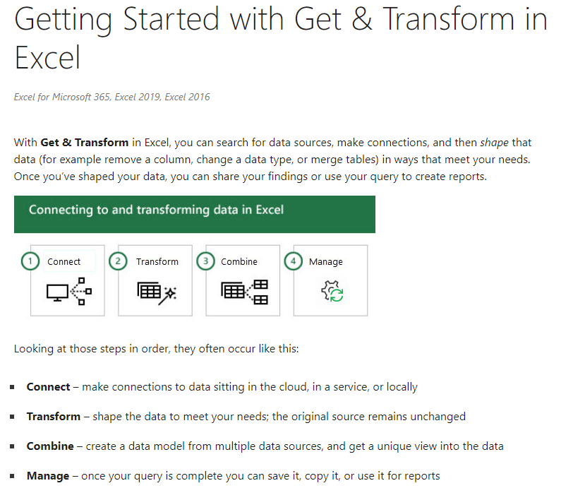
Excel has good features
https://support.microsoft.com/en-us/office/getting-started-with-get-transform-in-excel-a8310388-2a12-438c-9d29-c6d29cb8df6a

Slide 11
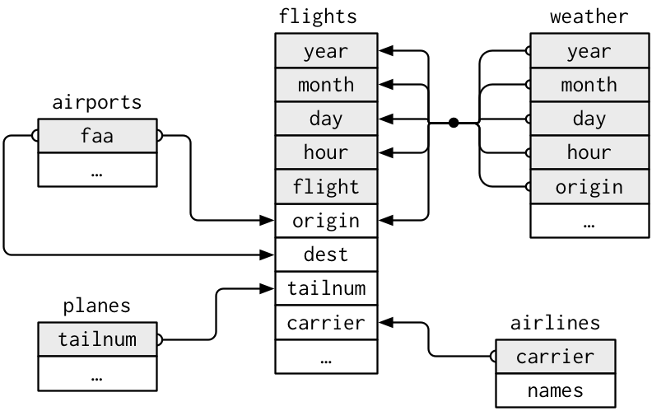
Think relationally! Joining data is a common task

Slide 12
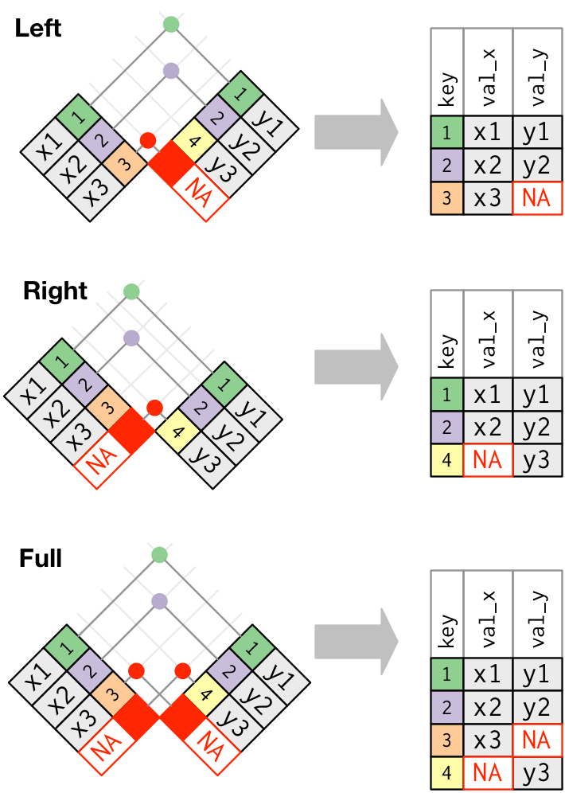
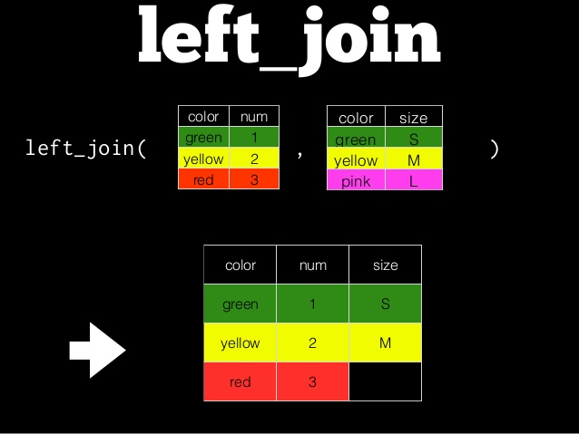
Dplyr has powerful joins

Slide 13
Summary
Know limitations (and strengths) of Excel http://kbroman.org/dataorg/
Use RStudio and make a R markdown document for every analysis you do
Focus on using dplyr, tidyr and ggplot for everything (or at least mostly everything) and learn all the functionality in these powerful libraries
Develop reliable data carpentry skills (version control, joins, programmatic analysis)

